Slide 1

High Level Group for the Modernization of Statistical Products and Services
Big Data: Big Opportunity!
Gosse van der Veen,
Statistics Netherlands
Statcom 2013 New York
<number>1

Slide 2
Background
We are a group of chief statisticians that are noticing the rapid changes occurring in the world and we want to modernize official statistics
Created by the CES bureau in 2010
10 heads of national and international statistical organizations
Strategic vision endorsed by CES in 2011/2012
Statcom 2013 New York

Slide 3
Members of the HLG
Gosse van der Veen (Netherlands) - Chairman
Brian Pink (Australia)
Eduardo Sojo Garza-Aldape (Mexico)
Enrico Giovannini (Italy)
Woo, Ki-Jong (Republic of Korea)
Irena Križman (Slovenia)
Katherine Wallman (United States)
Walter Radermacher (Eurostat)
Martine Durand (OECD)
Lidia Bratanova (UNECE)
Statcom 2013 New York

Slide 4

Problem Statement
http://www.youtube.com/watch?v=vkU2liaHZd4
2008!!
Statcom 2013 New York

Slide 5
Paradigm shift
In 1990 data were scarce,
interpretation was readily available
In 2013 data are everywhere, interpretation is scarce
From collecting to filtering of data
Statcom 2013 New York

Slide 6
It means that:
the sexy job in the next 10 years will be statistician
Or being in a seminar like this
Hal Varian
Anonymous
Statcom 2013 New York

Slide 7
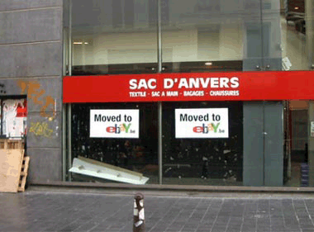
Observation:
The internet and big data are changing the way the world operates in a profound way
Statcom 2013 New York

Slide 8
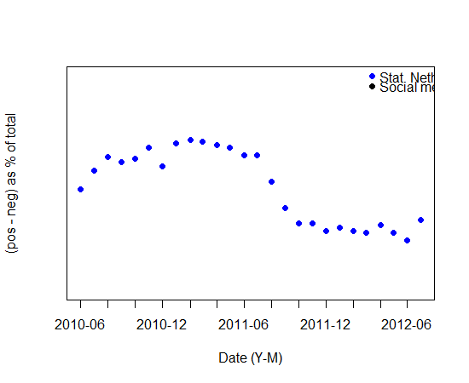
Small Data: Consumer confidence
Example 1
Sentiment towards the economic climate
Netherlands
Statcom 2013 New York
Piet Daas, Statistics Netherlands

Slide 9
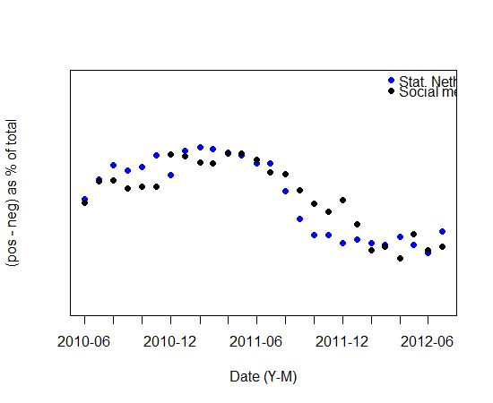
Big Data: Twitter text
Example 1
Sentiment towards the economic climate
and in Social Media
300 M/yr
Corr = 0.88
Netherlands
Statcom 2013 New York
Piet Daas, Statistics Netherlands

Slide 10
The Potential of Big Data
Seeing what you asked for versus asking yourself what you see;
In the first your model defines the info you want; in the second the info defines the model you need.
Statcom 2013 New York

Slide 11
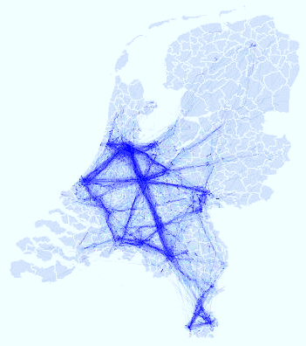
Big Data: Things !
Example 2
Easy to do
Insightful, more so than numbers
Outperforming surveys
Different type of quality
Verification needed
Telephone traffic
Piet Daas, Statistics Netherlands

Slide 12
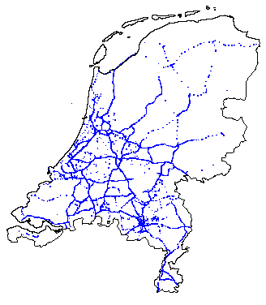
Big Data: Things !
Example 2
Vehicle traffic
Telephone traffic
Piet Daas, Statistics Netherlands

Slide 13
High Level Group
Vision and Strategy:
We have to re-invent our products and processes and adapt to a changed world
Statcom 2013 New York

Slide 14
On Products: Innovate!
Address the global dimension
  In the data and in the products
We need to learn to find data instead of surveying
  Procurement and harvesting
The exponential increase of data is the key: we MUST use those data

Slide 15
On Products: Innovate!
Take position in the (new) information value chain
Rethink our products related to needs of a changing society
  Who ARE our customers nowadays?
  And tomorrow?
Create pockets of innovation
  nurture talent and create right conditions
Statcom 2013 New York

Slide 16
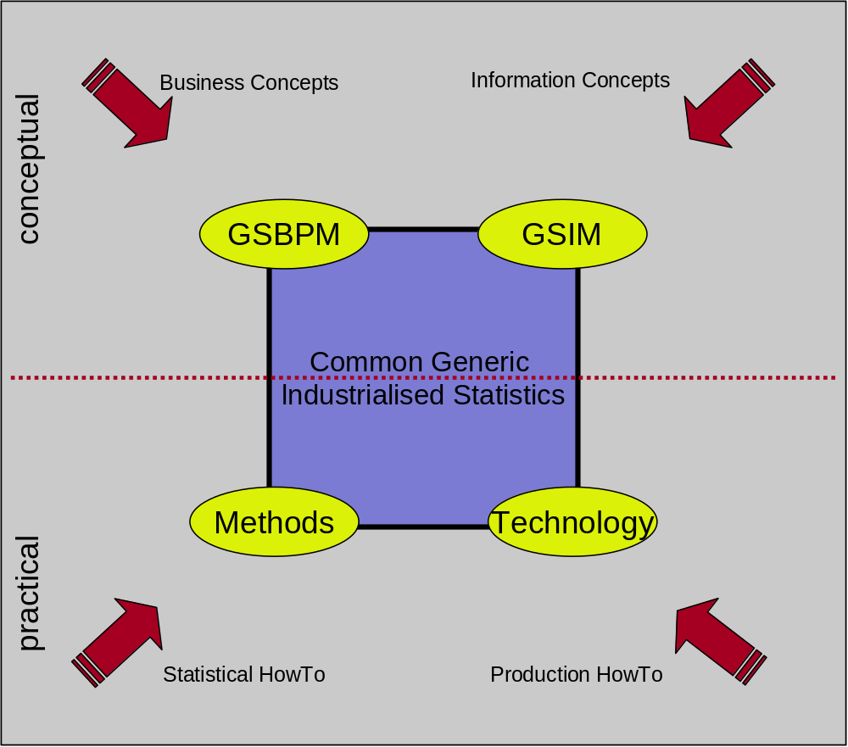
On Process: Modernise
reduce
diversity
Statcom 2013 New York

Slide 17
On Process: Modernise
Standards save money
New methods for large volumes of data
Minimize labor, innovate
Collaborate, ease the burden
Achieve process quality through standardisation
Statcom 2013 New York

Slide 18
Strategy: Governance
CES initiated, but is reaching out
HLG oversees execution of the strategy
    Directly in the CES-subordinate groups
    Formal governance arrangements underway
    New group structure pending
Yearly list of key priorities assigned to appropriate expert groups
2012 Санкт-Петербург

Slide 19
New Governance Structure
Conference of European Statisticians
CES Bureau
High Level Group
HLG
Secretariat
Organizational framework and evaluation
Production and methods
Products and sources
Standards
HLG Projects
Modernization Committees
Executive Board
Statcom 2013 New York

Slide 20
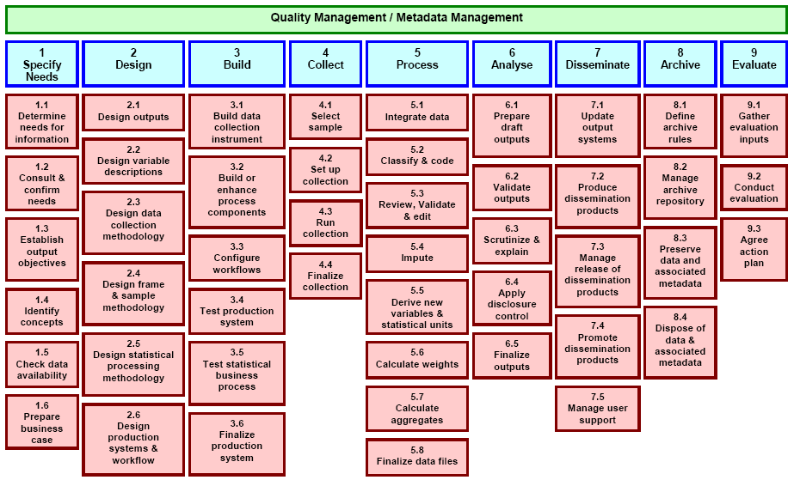
HLG Results
GSIM V1.0 (Generic Statistical Information Model)
now operational
as complement to the
GSBPM V4.0 (Generic Statistical Business Process Model)
Statcom 2013 New York

Slide 21
Provision Agreement
Provision for formalisation of arrangements for data acquisition and dissemination
Process Step Definition
Provider
Methodology applies to processes in all areas
Methodology
Balanced support for all data acquisition channels
Information Request
Process Method
Acquisition Program
Dissemination Program
Process management for all areas of activity
Business
Statistical Project
Production
Process Step Design
Separation of Statistical, Acquisition, and Dissemination programs, with central role for Methodology
Balanced support for multiple dissemination channels
G S I M V1.0
Statistical Program
Process Control
Process Step Execution
Statistical projects access shared data
Mapping of processes to support managed operations
Rule
Shared Data Resource, maintained corporately, for use by all statistical programs
Data Resource
Data Set
Statistical Products
Structures
Concepts
Variable
Population Units
Concept
Data Structure
Cube Structure
Unit Data Structure
Basic infrastructure for critical base elements
Value Domain
Record Structures
All structures and relationships described in metadata to support automated processes
Classification
GSIM sprint

Slide 22

HLG Results
Guidelines on
multilingual software
Statcom 2013 New York

Slide 23
What is it to you?
Statistics will change thoroughly
    Leveling the playing field
    Creating opportunities
Emerging economies can leapfrog
    Unburdened by legacy
    Creating better infrastructures
We, the HLG are committed to:
    Collaboration and sharing between NSOs
    Uniting the official statistical industry
Statcom 2013 New York

Slide 24
Next HLG steps
Project for CSPA (Common Statistical Process Architecture)
    Bringing GSBPM and GSIM to life
    Shareable modular production software
Big Data
    Position paper soon to be published
    Pilot projects; results in Autumn
Statcom 2013 New York

Slide 25
Next HLG steps
Possible Global conference on statistics end of this year??
    Finding the bright spots
    Sharing insights and solutions
Statcom 2013 New York

Slide 26
Conclusions
More challenges are uniform
More common solutions are possible
Time to work together
HLG wants to:
    Facilitate cooperation
    Help you find solutions for the balance between official statistics and the new challenges and possibilities
Statcom 2013 New York

Slide 27

Thank You
Google: UNECE HLG or:
Statcom 2013 New York

